Slide 1

19ECC01 – COMPUTER ARCHITECTURE AND ORGANIZATION

Slide 2
UNIT IV - MEMORY & I/O ORGANIZATION
Multilevel memories - Introduction & Definitions
Virtual Memory
Segments, Pages, Address Translation
Memory Allocation
Replacement Policies
Cache Memory
Cache Organization
Address Mapping (Direct Associative Mapping –Set Associative mapping)
Communication Interface
Onboard Communication Interfaces – I2C, SPI, UART –single wire interface, Parallel Interface
External Communication Interfaces –RS232C & RS485, USB, Firewire, Infrared, Bluetooth, Wi–Fi, Zigbee.

Slide 3
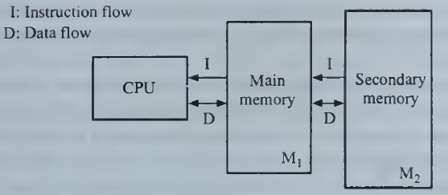
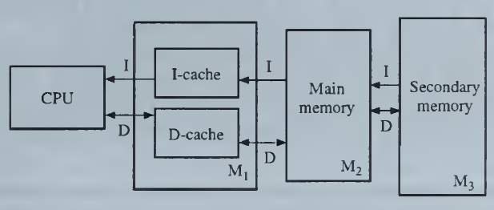
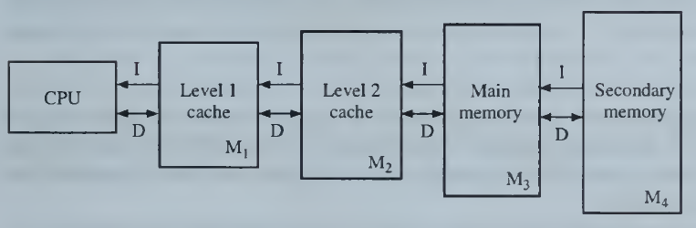
UNIT IV - MEMORY & I/O ORGANIZATION
Introduction:
Objective:
The object of this organization is to achieve a good trade-off between cost, storage capacity, and performance for the memory system as a whole.
Memory Hierarchy:
Two Level Memory
One Level Memory
Four Level Memory
Split cache: it has separate areas for storing instructions (the I-cache) and data (the D-cache).
Nonsplit or Unified Cache – no separate I & D Cache

Slide 4
UNIT IV - MEMORY & I/O ORGANIZATION
Introduction:
Relationship for M₁ and M_{i+1} level memory
Cost per bit c_{i} > c_{i+1}
Access time t_{Ai} < t_{Ai+1}
Storage capacity S_{i}< S_{i+l}
Memory data transfer occurs from M_{i} to M₁ and then to CPU
M_{i} to M_{i-1} to M_{i-2} to M_{i-3} ….. to M₁ to CPU
Reason for using Virtual Memory
To free user programs from the need to carry out storage allocation and to permit efficient sharing of the available memory space among different users.
To make programs independent of the configuration and capacity of the physical memory present for their execution; for example, to allow seamless overflow into secondary memory when the capacity of main memory is exceeded.
To achieve the very low access time and cost per bit that are possible with a memory hierarchy.

Slide 5
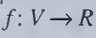
UNIT IV - MEMORY & I/O ORGANIZATION
Introduction:
Address Translation:
Identifying the Real Physical Address from Virtual Address
Locality of Reference
The referenced address is found in the Cache or Virtual Memory
Two Types:
Spatial Locality
Consecutive memory references (1000, 1004 and so on) that are close to one another in memory address space (sequence of program)
Temporal Locality
Repeatedly referenced address in memory space (Loops)

Slide 6
UNIT IV - MEMORY & I/O ORGANIZATION
Performance Parameters
1. Average Cost per bit
C = (C₁S₁ + C₂S₂)/(S₁ + S₂) C must be minimum
c_{i} denotes the cost per bit of M_{i} and
S_{i} denotes the storage capacity in bits of M_{i}.
2. Hit Ratio
H = (N₁)/(N₁ + N₂) H must be Maximum
N₁ Number of referenced addresses in M₁ and
N₂ Number of referenced addresses in M₂
3. Miss Ratio = (1 – H)
4. Average Access Time
t_{A} = Ht_{A1} + (1 – H) t_{A2}
When the block transfer has been completed, the requested word is available in M₁.
The time t_{B} required for the block transfer is called the block-access or block transfer time.
t_{A2} = t_{B} + t_{A1}
Now,
t_{A} = Ht_{A1} + (1 – H) (t_{B} + t_{A1})
t_{A} = t_{A1} + (1 – H) t_{B}

Slide 7
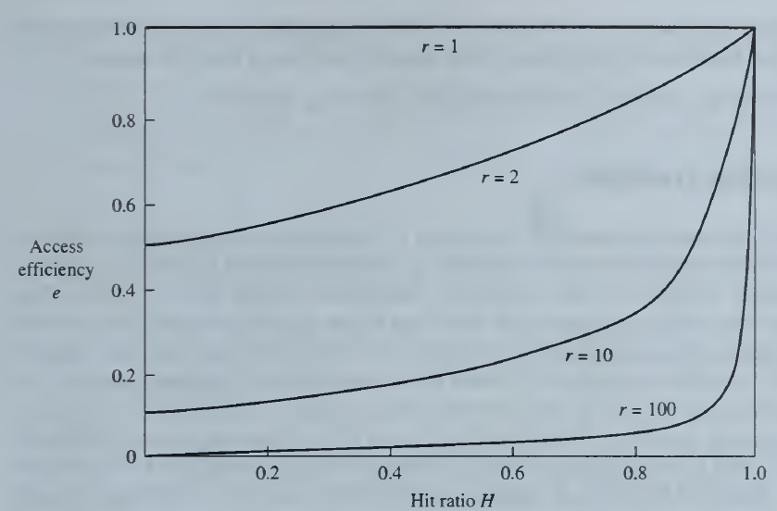
UNIT IV - MEMORY & I/O ORGANIZATION
Performance Parameters
5. Access Efficiency
Let r = t_{A2} / t_{A1} Ratio of Access time for M₁ and M₂
e = t_{A1} / t_{A} Factor to which t_{A} differs from its minimum possible value
Access Efficiency e = 1 / (r + (1-r))H)
When r=high (r=1), then the e=1 with high value of H.

Slide 8
UNIT IV - MEMORY & I/O ORGANIZATION
Performance Parameters
6. Space Utilization
u = S_{u} / S Ratio of Used Memory Space (S_{u}) and Total Space (S)
Wasted Space = S – S_{u}
Empty regions. The blocks of instructions and data occupying M_{l} at any time are generally of different lengths. As the contents of M, are changed, unoccupied regions or holes of various sizes tend to appear between successive blocks. This phenomenon is called fragmentation.
Inactive regions. Data may be transferred to M_{l}, for example, as part of a page, and may be subsequently transferred back to M, without ever being referenced by a processor. Some superfluous transfers of this kind are unavoidable, since address references are not fully predictable.
System regions. These regions are occupied by the memory-management software.
Objective
Translation of memory addresses from the virtual addresses encountered in program execution to the real addresses that identify physical storage locations.
Dynamic (re)allocation or swapping of information among the different memory levels so that stored items reside in the fastest level before they are needed.

Slide 9
UNIT IV - MEMORY & I/O ORGANIZATION
Address Translation
The Process of identifying the real addresses (R) from Virtual addresses (V)
Two Types,
Static Translation:
Address translation can also be completed when the program is first loaded for execution. The real address space of the program is fixed for the duration of its execution.
Dynamic Translation:
During the execution phase the addresses are dynamically generated. Hardware-implemented memory management units (MMUs) have come into widespread use for run-time address translation.
Methods
Base Addressing
Translation Look Aside Buffer
Two level Address Translation

Slide 10
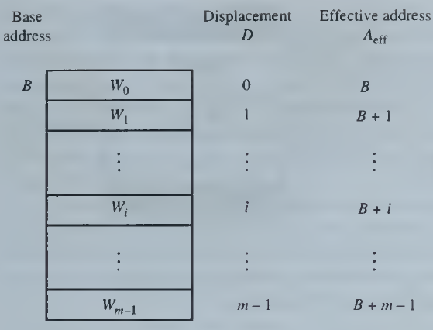
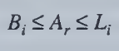

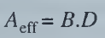
UNIT IV - MEMORY & I/O ORGANIZATION
Address Translation
Base Addressing
B – Base Address - Starting Address of the Block
D - Displacement
L – Limit Address – End of Maximum address of the virtual space
or
Every real address Ar generated by the block is compared to Bj and Li; the memory access is completed if and only if the condition is satisfied.

Slide 11
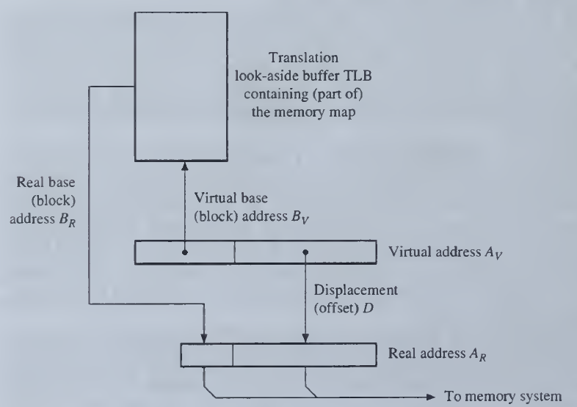
UNIT IV - MEMORY & I/O ORGANIZATION
Address Translation
2. Translation Look Aside Buffer

Slide 12
UNIT IV - MEMORY & I/O ORGANIZATION
Address Translation
2. Translation Look Aside Buffer
The input address Av is a virtual address consisting of a (virtual) base address Bv concatenated with a displacement D. Av contains an effective address computed in accordance with some program-defined addressing mode (direct, indirect, indexed, and so on) for the memory item being accessed.
The real address BR = f(Bv) assigned to Bv is stored in a memory map somewhere in the memory system; this map can be quite large. To speed up the mapping process, the memory map is placed in a small high-speed memory in the CPU called a translation look-aside buffer (TLB).
The TLB's input is thus the base-address part Bv of Av; its output is the corresponding real base address BR . This address is then concatenated with the D part of Av to obtain the full physical address AR.
If the virtual address Bv is not currently assigned to the TLB, then the part of the memory map that contains Bv is first transferred from the external memory into the TLB. For this reason, the TLB is sometimes referred to as an address cache.

Slide 13
UNIT IV - MEMORY & I/O ORGANIZATION
Address Translation
Segments
Physical Memory
Segments (Variable Size)
Pages (Fixed Size)
Virtual Memory
Segments
S1
S2
S3
Pages
P1
P2
P3
Formally, a segment is a set of logically related, contiguous words; A word in a segment is referred to by specifying a base address—the segment address—and a displacement within the segment.
A program and its data can be viewed as a collection of linked segments.
Some computers have a memory management technique that allocates main memory by M₁ segments alone. When a segment not currently resident in M₁ is required, the entire segment is transferred from secondary memory M₂.
The physical addresses assigned to the segments are kept in a memory map called a segment table

Slide 14
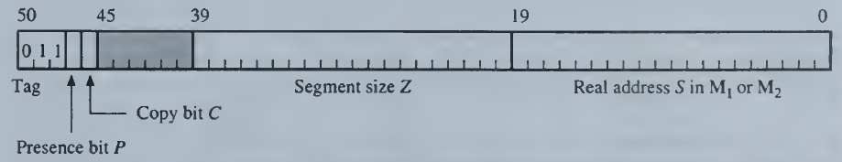
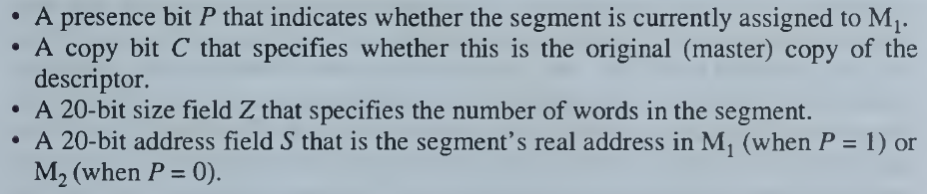
UNIT IV - MEMORY & I/O ORGANIZATION
Address Translation
Segments

Slide 15
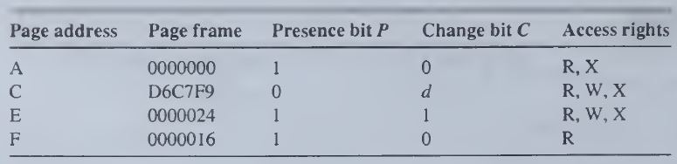
UNIT IV - MEMORY & I/O ORGANIZATION
Address Translation
Pages
A page is a fixed-length block that can be assigned to fixed regions of physical memory called page frames. The chief advantage of paging is that data transfer between memory levels is simplified: an incoming page can be assigned to any available page frame.
Each virtual address consists of two parts: a page address and a displacement. The memory map, now referred to as a page table.
Organization of a page table.
Fragmentation
Unused spaces in the Physical or Main memory which is segmented.
External Fragmentation: Unused spaces between the occupied pages in segment
Internal Fragmentation: Unusable space within a partially filled page

Slide 16
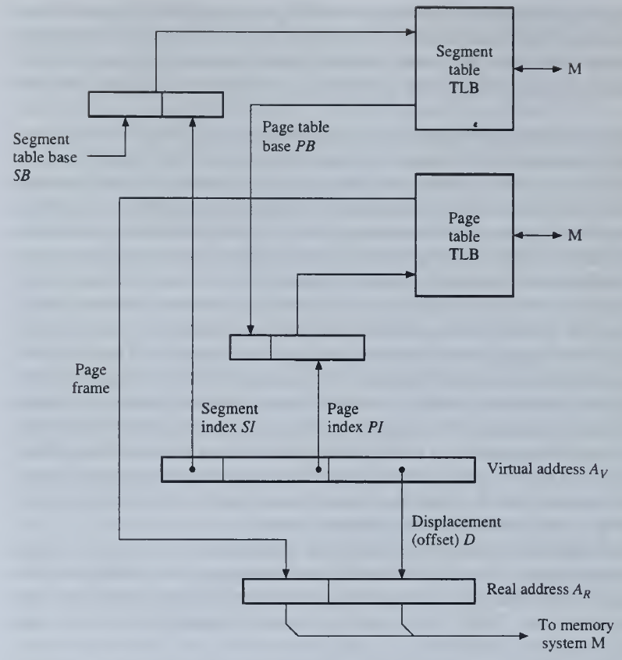
UNIT IV - MEMORY & I/O ORGANIZATION
Address Translation
3. Two-stage address translation with segments and pages

Slide 17
UNIT IV - MEMORY & I/O ORGANIZATION
Address Translation
3. Two-stage address translation with segments and pages
When segmentation is used with paging, a virtual address has three components: a segment index SI, a page index PI, and a displacement (offset) D.
The memory map then consists of one or more segment tables and page tables.
The TLBs serve as fast caches for the memory maps. Every virtual address Av generated by a program goes through a two-stage translation process.
First, the segment index SI is used to read the current segment table to obtain the base address PB of the required page table.
This base address is combined with the base index PI (which is just a displacement within the page table) to produce a page address, which is then used to access a page table.
The result is a real page address, that is, a page frame number, which can be combined with the displacement part D of Av to give the final (real) address A_{R}.

Slide 18
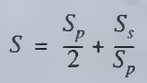
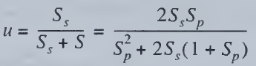
UNIT IV - MEMORY & I/O ORGANIZATION
Address Translation
Page Size
The page size Sp has a big impact on both storage utilization and the effective memory data-transfer rate.
Consider first the influence of Sp on the space-utilization factor u defined earlier.
If Sp is too large, excessive internal fragmentation results; if Sp is too small, the page tables become very large and tend to reduce space utilization.
Let Ss denote the average segment size
If Ss >> Sp, the last page assigned to a segment should contains about Sp/2 words.
The size of the page table associated with each segment is approximately Ss/Sp words, assuming each entry in the table is a word.
Hence the memory space overhead associated with each segment is
The space utilization u is

Slide 19
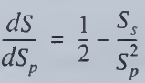
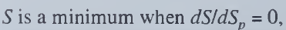
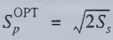
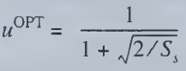
UNIT IV - MEMORY & I/O ORGANIZATION
Address Translation
Page Size
The optimum space utilization is

Slide 20
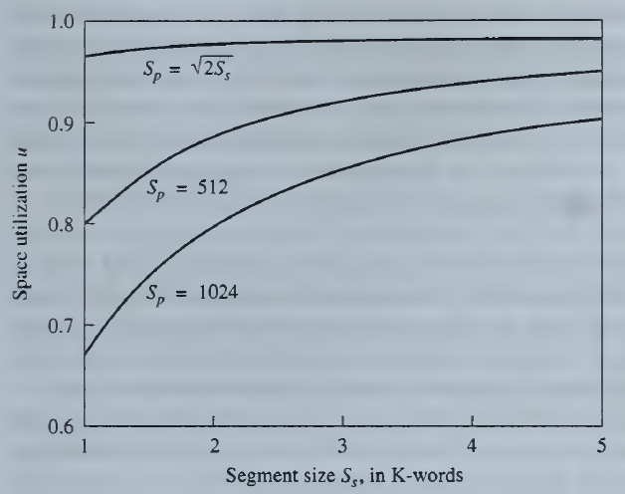
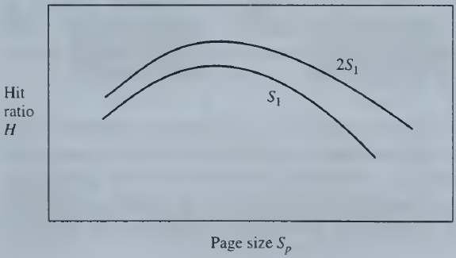
UNIT IV - MEMORY & I/O ORGANIZATION
Address Translation
Page Size
Influence of page size Sp on hit ratio H.
Influence of page size Sp and segment size Ss on space utilization u.

Slide 21
UNIT IV - MEMORY & I/O ORGANIZATION
Memory Allocation
Two Methods,
Non-Preemptive Allocation
First Fit
Best Fit
Preemptive Allocation
Relocation of Block – Compaction
De-allocation of Block – FIFO, LRU, OPT

Slide 22
UNIT IV - MEMORY & I/O ORGANIZATION
Memory Allocation
Swapping Two Types,
Demand Swapping
When the processor request for the information or data
Anticipatory Swapping
The data or information moved to Cache memory based on some anticipation to increase the performance.

Slide 23
UNIT IV - MEMORY & I/O ORGANIZATION
Memory Allocation
The placement of blocks of information in a memory system is called memory allocation
The method of selecting the part of M, in which an incoming block K is to be placed is the replacement policy.
If the hit ratio is low, an excessive amount of swapping between memory levels occurs, a phenomenon known as thrashing.
A memory map that contains the following information:
Occupied space list for M₁: Each entry of this list specifies a block name, the (base) address of the region it occupies, and, if variable, the block size. In systems using preemptive allocation, additional information is associated with each block to determine when and how it can be preempted.
Available space list for M₁: Each entry of this list specifies the address of an unoccupied region and, if necessary, its size.
Directory for M₂: This list specifies the unit(s) that contain the directories for all the blocks associated with the current programs. These directories, in turn, define the regions of the M2 space to which each block is assigned.

Slide 24
UNIT IV - MEMORY & I/O ORGANIZATION
Memory Allocation
Non-Preemptive Allocation
First Fit
When scan find the required available free space for the incoming Block Ki, then the block is placed there.
Best Fit
It scans the entire page, places the incoming block based on the minimum space availability after the allocation process.

Slide 25
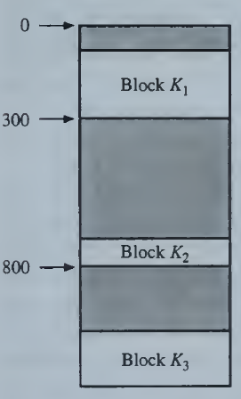
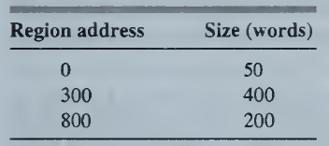
UNIT IV - MEMORY & I/O ORGANIZATION
Memory Allocation
Non-Preemptive Allocation - Example
Available Space List
Occupied Space List
K₁: 51 to 300 (250)
K₂: 701 to 800 (100)
K₃:1001 to 1300 (300)
Incoming Block sizes: K₄ = 100; K₅ = 250

Slide 26
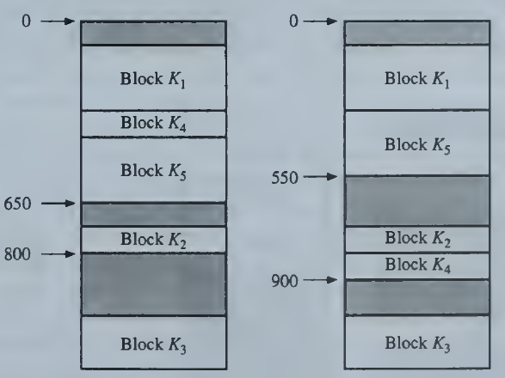
UNIT IV - MEMORY & I/O ORGANIZATION
Memory Allocation
Non-Preemptive Allocation - Example
First Fit
Best Fit
Simple, Less Time, but not effective
Complex, More Time, but effective

Slide 27
UNIT IV - MEMORY & I/O ORGANIZATION
Memory Allocation
Preemptive Allocation
Reallocation may be done in two ways:
The blocks already in M₁ can be relocated within M₁, to create a gap large enough for the incoming block.
One or more occupied regions can be made available by deallocating the blocks they contain. This method requires a rule—a replacement policy—for selecting blocks to be deallocated and replaced.

Slide 28
UNIT IV - MEMORY & I/O ORGANIZATION
Memory Allocation
Preemptive Allocation
A Deallocation policy
Deallocation requires that a distinction be made between "dirty" blocks, which have been modified since being loaded into M₁, and "clean" blocks, which have not been modified.
Blocks of instructions remain clean, whereas blocks of data can become dirty.
To replace a clean block, the memory management system can simply overwrite it with the new block and update its entry in the memory map.
Before a dirty block is overwritten, it should be copied to M₂ , which involves a slow block transfer.

Slide 29
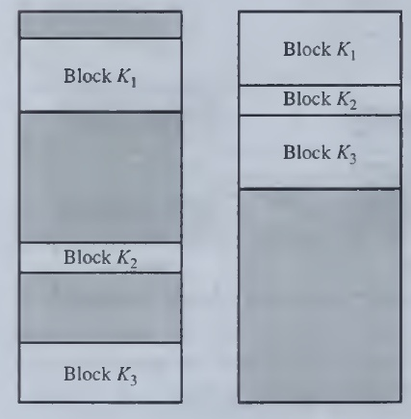
UNIT IV - MEMORY & I/O ORGANIZATION
Memory Allocation
Preemptive Allocation
A Relocation policy - Compaction
The blocks currently in memory are compressed into a single contiguous group at one end of the memory.
This creates an available region of maximum size.
Once the memory is compacted, incoming blocks are assigned to contiguous regions at the unoccupied end.
Memory allocation (a) before and (b) after
compaction.

Slide 30
UNIT IV - MEMORY & I/O ORGANIZATION
Memory Allocation
Preemptive Allocation – Page Replacement Policies
A Deallocation policy – FIFO, LRU and OPT
In an operating system that uses paging for memory management, a page replacement algorithm is needed to decide which page needs to be replaced when new page comes in.
Page Replacement Algorithms
First In First Out (FIFO)
In this algorithm, the operating system keeps track of all pages in the memory in a queue, the oldest page is in the front of the queue. When a page needs to be replaced page in the front of the queue is selected for removal.
Least Recently Used (LRU)
In this algorithm page will be replaced which is least recently used.
Optimal Page replacement (OPT)
In this algorithm, pages are replaced which would not be used for the longest duration of time in the future.

Slide 31
UNIT IV - MEMORY & I/O ORGANIZATION
Memory Allocation
Preemptive Allocation – Page Replacement Policies
First In First Out (FIFO)
As the name suggests, this algorithm works on the principle of “First in First out“.
It replaces the oldest page that has been present in the main memory for the longest time.
It is implemented by keeping track of all the pages in a queue.
Least Recently Used (LRU)
As the name suggests, this algorithm works on the principle of “Least Recently Used“.
It replaces the page that has not been referred by the CPU for the longest time.
Age Register: Every time the page is referenced, that page is assigned with largest positive number. At every interval of time, age registers of all the blocks are decremented by a fixed amount. The least recently used block at any time is the one whose age register contains the smallest number.
Optimal Page replacement (OPT)
Replaces the page that will not be referred by the CPU in future for the longest time.
It is practically impossible to implement this algorithm.
This is because the pages that will not be used in future for the longest time can not be predicted.
However, it is the best known algorithm and gives the least number of page faults.
Hence, it is used as a performance measure criterion for other algorithms.

Slide 32
UNIT IV - MEMORY & I/O ORGANIZATION
Memory Allocation
Preemptive Allocation – Page Replacement Policies
Example:

Slide 33
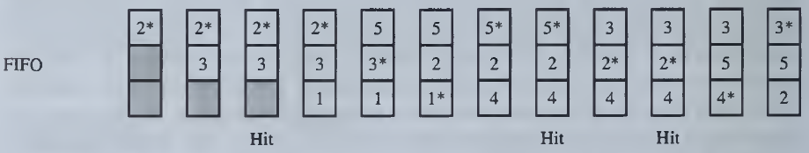
UNIT IV - MEMORY & I/O ORGANIZATION
Memory Allocation
Preemptive Allocation – Page Replacement Policies
Example:
FIFO

Slide 34
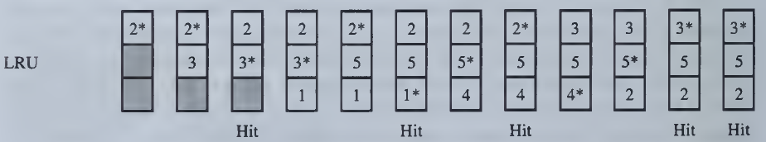
UNIT IV - MEMORY & I/O ORGANIZATION
Memory Allocation
Preemptive Allocation – Page Replacement Policies
Example:
LRU

Slide 35
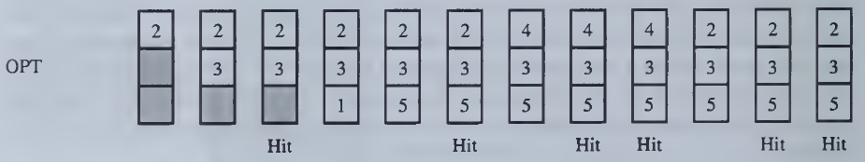
UNIT IV - MEMORY & I/O ORGANIZATION
Memory Allocation
Preemptive Allocation – Page Replacement Policies
Example:
OPT

Slide 36
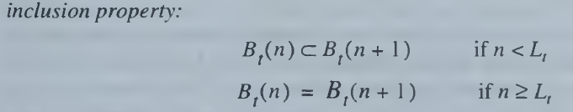
UNIT IV - MEMORY & I/O ORGANIZATION
Memory Allocation
Preemptive Allocation – Page Replacement Policies
(Stack Algorithm)
Stack Algorithm:
An Algorithm said to be Stack algorithm, if it satisfies INCLUSION Property
Where,
n – Page capacity of M₁
AT – Address Trace
B_{t}(n) – Set of pages in M₁ at time t
L_{t} – number of distinct pages have been encountered

Slide 37
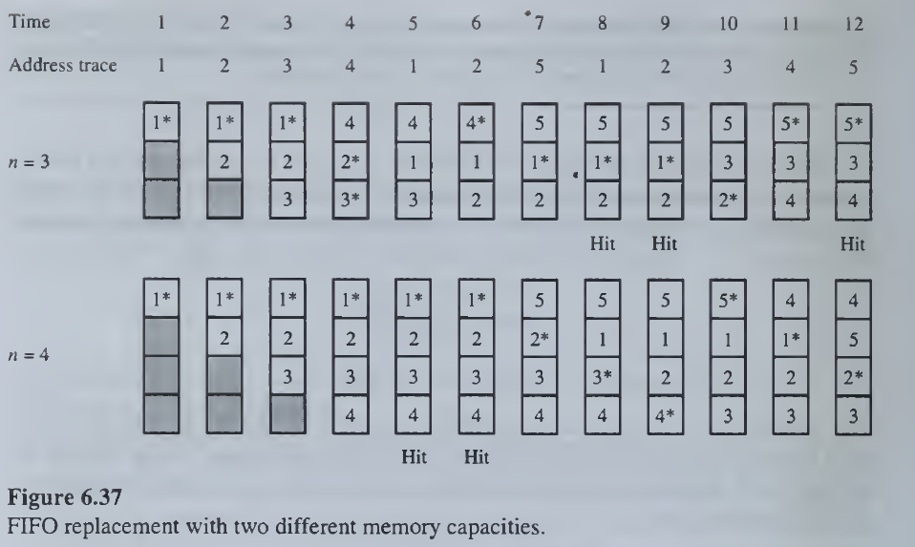
UNIT IV - MEMORY & I/O ORGANIZATION
Memory Allocation
Preemptive Allocation – Page Replacement Policies
(Stack Algorithm)

Slide 38
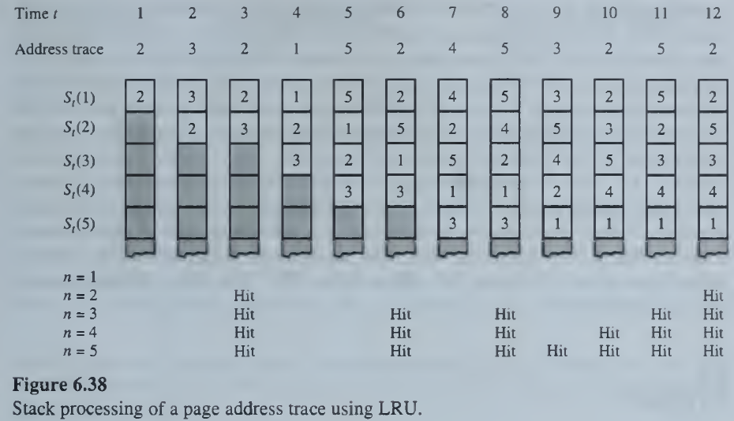
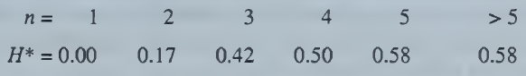
UNIT IV - MEMORY & I/O ORGANIZATION
Memory Allocation
Preemptive Allocation – Page Replacement Policies
(Stack Algorithm)

Slide 39
UNIT IV - MEMORY & I/O ORGANIZATION
Memory Allocation
Preemptive Allocation – Page Replacement Policies
Other Algorithms:
Direct mapping
Each incoming block from M₂ is assigned to a fixed region of M₁, determined by the block's low-order address bits.
Random
As the name suggests, this algorithm randomly replaces any page.
So, this algorithm may behave like any other algorithm like FIFO, LIFO, LRU, Optimal etc.
LIFO
As the name suggests, this algorithm works on the principle of “Last in First out“.
It replaces the newest page that arrived at last in the main memory.
It is implemented by keeping track of all the pages in a stack.

Slide 40
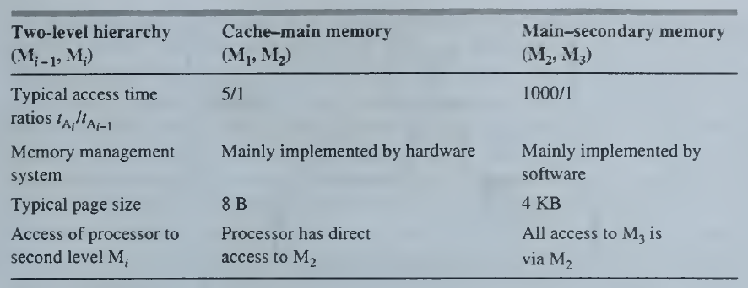
UNIT IV - MEMORY & I/O ORGANIZATION
Cache Memory
The term cache refers to a fast intermediate memory within a larger memory system.
Caches directly providing the CPU with fast, single-cycle access to its external memory.
A cache serves as a buffer between a CPU and its main memory.
Features:

Slide 41
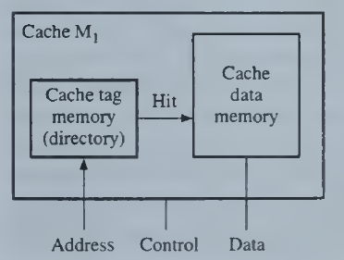
UNIT IV - MEMORY & I/O ORGANIZATION
Cache Memory
Cache Organization
Memory words are stored in a cache data memory and are grouped into small pages called cache blocks or lines.
The contents of the cache's data memory are thus copies of a set of main-memory blocks.
Each cache block is marked with its block address, referred to as a tag, so the cache knows to what part of the memory space the block belongs.
The collection of tag addresses currently assigned to the cache, which can be non--continguous, is stored in a special memory, the cache tag memory or directory.
Basic structure of a cache.

Slide 42
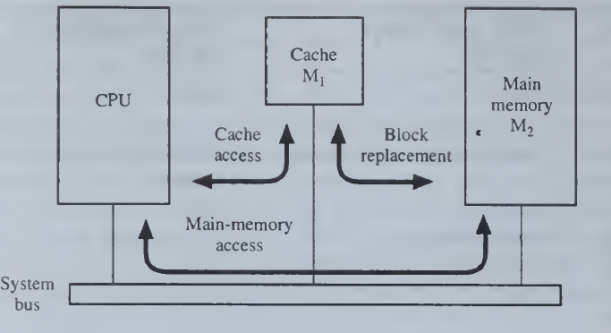
UNIT IV - MEMORY & I/O ORGANIZATION
Cache Memory
Cache Organization
The cache and the main memory are directly connected to the system bus.
Here the CPU initiates a memory access by placing a (real) address A, on the memory address bus at the start of a read (load) or write (store) cycle.
The cache M, immediately compares Ai, to the tag addresses currently residing in its tag memory.
If a match is found in M₁, that is, a cache hit occurs, the access is completed by a read or write operation executed in the cache; main memory M₂ is not involved.
If no match with A, is found in the cache, that is, a cache miss occurs, then the desired access is completed by a read or write operation directed to M2 .
In response to a cache miss, a block (line) of data Bj that includes the target address Ai is transferred from M₂ to M₁..
Cache look-aside

Slide 43
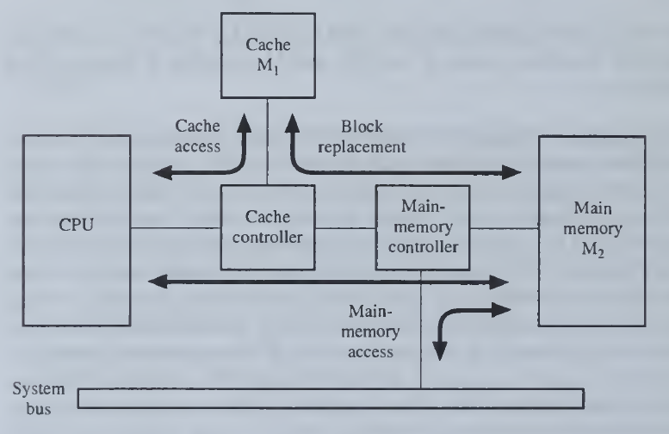
UNIT IV - MEMORY & I/O ORGANIZATION
Cache Memory
Cache Organization
A faster, but more costly organization called a look-through cache.
The CPU communicates with the cache via a separate (local) bus that is isolated from the main system bus.
The system bus is available for use by other units, such as IO controllers, to communicate with main memory.
Unlike the look-aside case, with a look-through cache the CPU does not automatically send all memory requests to main memory; it does so only after a cache miss.
A look-through cache allows the local bus linking M₁, and M₂ to be wider than the system bus, thus speeding up cache-main-memory transfers.
Cache look-thorugh
The main disadvantage of the look-through design, besides its higher complexity and cost, is that it takes longer for M₂ to respond to the CPU when a miss occurs.

Slide 44
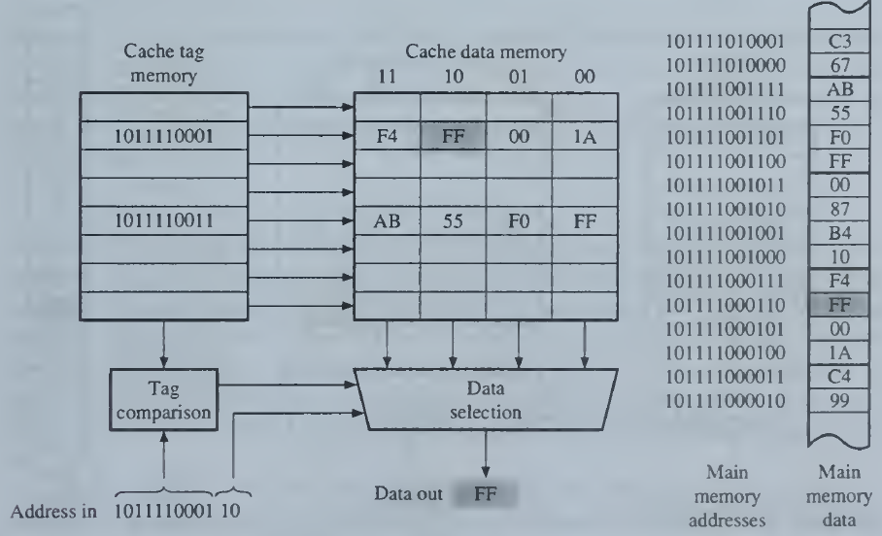
UNIT IV - MEMORY & I/O ORGANIZATION
Cache Memory
Cache Operation - Read

Slide 45
UNIT IV - MEMORY & I/O ORGANIZATION
Cache Memory
Cache Operation - Read
Here a cache block (line) size of 4 bytes is assumed.
Each memory address is 12 bits long, so the 10 high-order bits form the tag or block address, and the 2 low-order bits define a displacement address within the block.
When a block is assigned to M₁'s data memory, its tag is also placed in M₁’s tag memory.
Figure shows the contents of two blocks assigned to the cache data memory; note the locations of the same blocks in main memory.
To read the shaded word, its address Aj = 10111 10001 10 is sent to Mj, which compares A,'s tag part to its stored tags and finds a match (hit).
The stored tag pinpoints the corresponding block in Mj's data memory, and the 2-bit displacement is used to output the target word to the CPU.

Slide 46
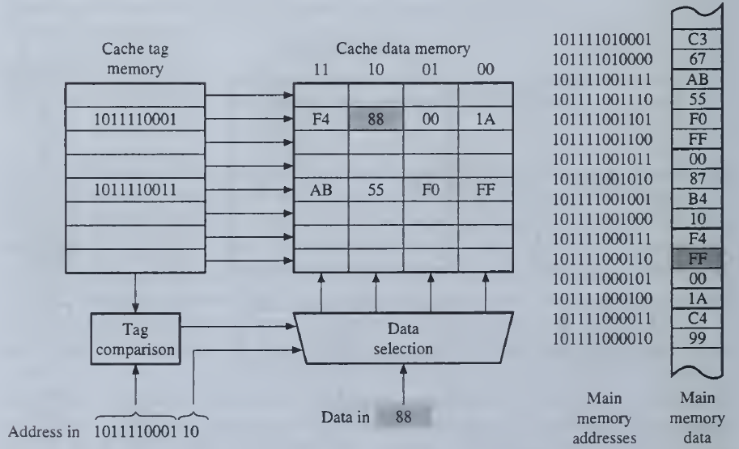
UNIT IV - MEMORY & I/O ORGANIZATION
Cache Memory
Cache Operation - Write

Slide 47
UNIT IV - MEMORY & I/O ORGANIZATION
Cache Memory
Cache Operation - Write
The tag part of the target address Ai, is again presented to M₁, along with the data word to be stored.
When a hit occurs, the new data, in this case, 88, is stored at the location pointed to by Ai, in the data memory of M₁, thereby overwriting the old data FF.
Now a new problem arises:
The data in M₁, with address Ai, differs from the data in M₂ with the same address.
It is called as Cache Inconsistency.
Preventing the improper use of stale data is the cache coherence or cache consistency problem.

Slide 48
UNIT IV - MEMORY & I/O ORGANIZATION
Cache Memory
Cache Operation - Write
Cache Inconsistency
Two Solutions:
Write-back or Copy back
Write-through

Slide 49
UNIT IV - MEMORY & I/O ORGANIZATION
Cache Memory
Cache Operation - Write
Write-back or Copy back
Each cache block in the data memory of M₁, can have a change bit C attached to it, which is set to when the block is first placed in M₁.
Any subsequent write operation addressed to that block sets C to 1.
When a block with C = 1 is replaced, its data contents are then written back to main memory M2 .
This technique is referred to as write-back or copy-back.
It has the disadvantage that M, and M2 can be temporarily inconsistent, that is, have different data associated with the same physical address.
The write-back technique also complicates recovery from system failures.
Write-Through
An alternative to write-back is to transfer the data word to both M₁, and M₂ during every memory write cycle, even when the target address is already assigned to the cache.
This policy, called write-through, is easy to implement, and it guarantees that M₂ never contains stale information.
On the other hand, write-through results in more write cycles to M₂, than write-back does.
Since the time needed for each write is then the slower (write) access time of M₂, system performance may suffer.

Slide 50
UNIT IV - MEMORY & I/O ORGANIZATION
Cache Memory
Structure versus Performance
An instruction or I-cache stores instructions only, while a data or D-cache stores data only.
A cache that stores both instructions and data is referred to as unified. A split cache, on the other hand, consists of two associated but largely independent units: an I-cache for instructions and a D-cache for data. While a unified cache is simpler, a split cache makes it possible to access programs and data concurrently. A split cache can also be designed to manage its I- and D-cache components differently.
Caches are also classified by the level they occupy in the memory hierarchy. A level 1 (LI) or primary cache is an efficient way to implement an on-chip memory. An additional memory level can be introduced via an off-chip, level 2 (L2) or secondary cache.

Slide 51
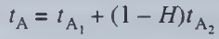
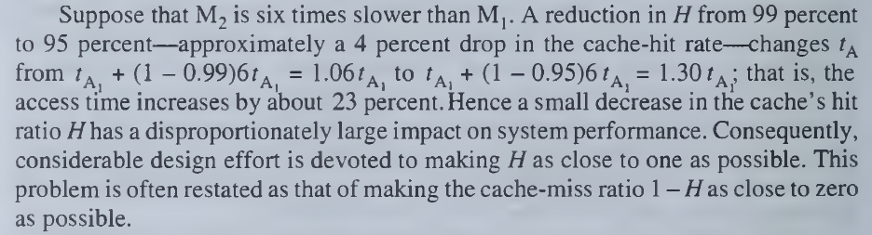
UNIT IV - MEMORY & I/O ORGANIZATION
Cache Memory
Structure versus Performance

Slide 52
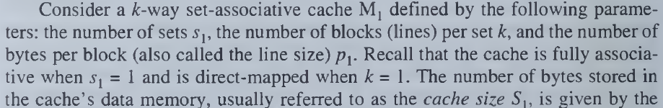
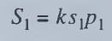
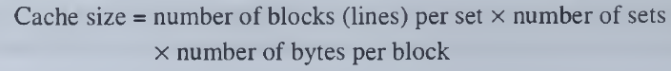
UNIT IV - MEMORY & I/O ORGANIZATION
Cache Memory
Structure versus Performance

Slide 53
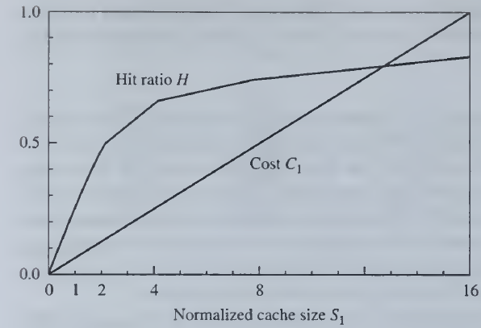
UNIT IV - MEMORY & I/O ORGANIZATION
Cache Memory
Structure versus Performance
Influence of cache size on hit ratio and cost

Slide 54
UNIT IV - MEMORY & I/O ORGANIZATION
Cache Memory
Cache Address Mapping:
Direct Mapping
Fully Associative Mapping
K-way Set Associative Mapping

Slide 55
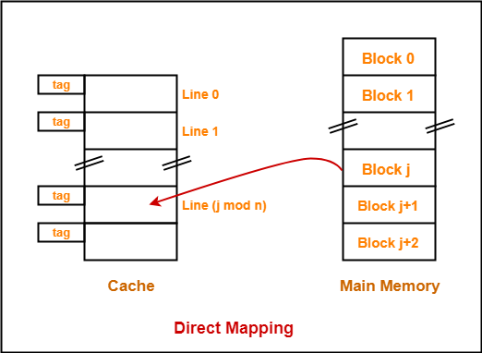
UNIT IV - MEMORY & I/O ORGANIZATION
Cache Memory
1. Direct Mapping
In direct mapping, A particular block of main memory can map only to a particular line of the cache.
Cache line number = ( Main Memory Block Address ) Modulo (Number of lines in Cache)
Consider cache memory is divided into ‘n’ number of lines.
Then, block ‘j’ of main memory can map to line number (j mod n) only of the cache.

Slide 56
UNIT IV - MEMORY & I/O ORGANIZATION
Cache Memory
1. Direct Mapping
Simplest way of mapping
Main memory is divided in blocks
Block j of the main memory is mapped onto block j modulo 128 of the cache – consider a cache of 128 blocks of 16 words each.
Consider a memory of 64K words divided into 4096 blocks
Advantage
Simplest replacement algorithm
Disadvantage
Not flexible– there is contention problem even when cache is not full
For example, block 0 and block 128 both take only block 0 of cache: –
0 modulo 128 = 0
128 modulo 128 = 0
If both blocks 0 and 128 of the main memory are used a lot, it will be very slow

Slide 57
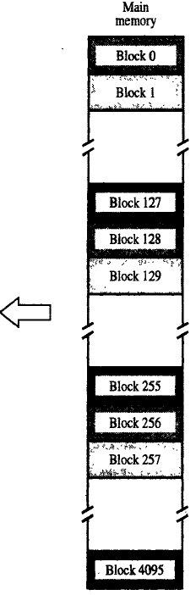
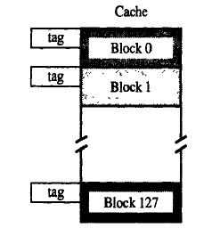
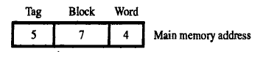
UNIT IV - MEMORY & I/O ORGANIZATION
Cache Memory
1. Direct Mapping

Slide 58
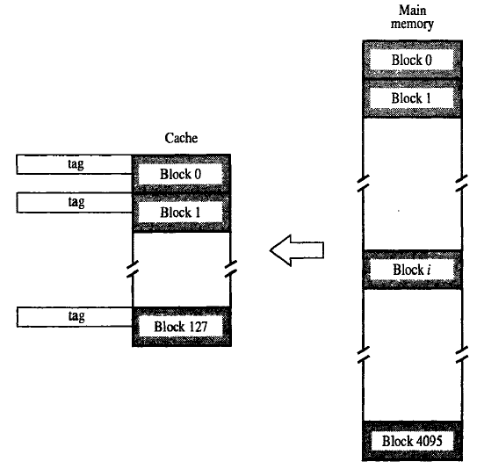
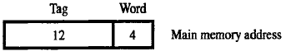
UNIT IV - MEMORY & I/O ORGANIZATION
Cache Memory
2. Fully Associative Mapping

Slide 59
UNIT IV - MEMORY & I/O ORGANIZATION
Cache Memory
2. Fully Associative Mapping
Any block can go anywhere in cache.
4095 blocks -> 4095 tag = 2 ¹² -> 12 bit tag
Advantage:
Associative mapping is very flexible technique because in which all content and addresses of memory word are saved into associative memory.
Fastest and great flexible.
Each block is capable to enter in the cache’s line.
So, it can be identified that word is necessary with help of word id bits in the block, and due to this get possible to swap any word on the any area in the cache memory.
So, we can consider that associative mapping is fastest and great flexible.
Disadvantage:
Must check all tags to check for a hit, expensive

Slide 60


UNIT IV - MEMORY & I/O ORGANIZATION
Cache Memory
3. K-way Associative Mapping

Slide 61
UNIT IV - MEMORY & I/O ORGANIZATION
Cache Memory
3. K-way Associative Mapping
Comprise between direct mapping and associative Mapping
Block in main memory maps to a set of blocks in cache – direct mapping
Can map to any block within the set
E.g. use 6 bits for tag = 2 = 64 tags
6 bits for set = 2 = 64 sets
The blocks in cache are divided into 64 sets and there are two blocks in each set
Main memory blocks 0, 64, 128, 4032 maps to set 0 and can occupy either of the two positions
Advantage: Low Cost and Flexible.
If the K = 1 then it is Direct Mapping
If the K = 128 then it is Associative Mapping

Slide 62

UNIT IV - MEMORY & I/O ORGANIZATION
Cache Memory
Cache Mapping Technique:-
The different Cache mapping technique are as follows:-
1) Direct Mapping
2) Associative Mapping
3) Set Associative Mapping
Consider a cache consisting of 128 blocks of 16 words each, for total of 2048(2K) works and assume that the main memory is addressable by 16 bit address. Main memory is 64K which will be viewed as 4K blocks of 16 works each.
For Animations: https://www.scss.tcd.ie/Jeremy.Jones/VivioJS/caches/cache.htm
http://williamstallings.com/COA/Animation/Links.html

Slide 63

UNIT IV - MEMORY & I/O ORGANIZATION
Cache Memory
1. Direct Mapping
1) The simplest way to determine cache locations in which store Memory blocks is direct Mapping technique.
2) In this block J of the main memory maps on to block J modulo 128 of the cache. Thus main memory blocks 0,128,256,….is loaded into cache is stored at block 0. Block 1,129,257,….are stored at block 1 and so on.
3) Placement of a block in the cache is determined from memory address. Memory address is divided into 3 fields, the lower 4-bits selects one of the 16 words in a block.
4) When new block enters the cache, the 7-bit cache block field determines the cache positions in which this block must be stored.
5) The higher order 5-bits of the memory address of the block are stored in 5 tag bits associated with its location in cache. They identify which of the 32 blocks that are mapped into this cache position are currently resident in the cache.
6) It is easy to implement, but not Flexible

Slide 64

UNIT IV - MEMORY & I/O ORGANIZATION
Cache Memory
2. Fully Associative Mapping
1) This is more flexible mapping method, in which main memory block can be placed into any cache block position.
2) In this, 12 tag bits are required to identify a memory block when it is resident in the cache.
3) The tag bits of an address received from the processor are compared to the tag bits of each block of the cache to see, if the desired block is present. This is known as Associative Mapping technique.
4) Cost of an associated mapped cache is higher than the cost of direct-mapped because of the need to search all 128 tag patterns to determine whether a block is in cache. This is known as associative search.

Slide 65

UNIT IV - MEMORY & I/O ORGANIZATION
Cache Memory
3. K-way Associative Mapping
1) It is the combination of direct and associative mapping technique.
2) Cache blocks are grouped into sets and mapping allow block of main memory reside into any block of a specific set. Hence contention problem of direct mapping is eased, at the same time, hardware cost is reduced by decreasing the size of associative search.
3) For a cache with two blocks per set. In this case, memory block 0, 64, 128,…..,4032 map into cache set 0 and they can occupy any two block within this set.
4) Having 64 sets means that the 6 bit set field of the address determines which set of the cache might contain the desired block. The tag bits of address must be associatively compared to the tags of the two blocks of the set to check if desired block is present. This is two way associative search.

Slide 66
https://upscfever.com/upsc-fever/en/gatecse/en-gatecse-chp168.html
https://www.geeksforgeeks.org/page-replacement-algorithms-in-operating-systems/
https://www.gatevidyalay.com/page-replacement-algorithms-page-fault/

Slide 67
https://www.gatevidyalay.com/page-replacement-algorithms-page-fault/
A system uses 3 page frames for storing process pages in main memory. It uses the First in First out (FIFO) page replacement policy. Assume that all the page frames are initially empty. What is the total number of page faults that will occur while processing the page reference string given below-
4 , 7, 6, 1, 7, 6, 1, 2, 7, 2
Also calculate the hit ratio and miss ratio.
https://www.geeksforgeeks.org/page-replacement-algorithms-in-operating-systems/
Example-2:Consider the page references 7, 0, 1, 2, 0, 3, 0, 4, 2, 3, 0, 3, 2, with 4 page frame. Find number of page fault.

Slide 68
https://www.gatevidyalay.com/cache-mapping-cache-mapping-techniques/
https://www.ques10.com/p/11169/explain-cache-memory-and-describe-cache-mapping--1/

